Slide 1
ONLINE ARTISANS STORE
PIP2001 Capstone Project
Review-1
Batch Number: CIT-G36
Under the Supervision of,
Ms. Sridevi S
Dr./Mr./Ms./Prof.
Professor / Associate Professor / Assistant Professor
School of Computer Science and Engineering
Presidency University
Roll Number | Student Name
20211CIT0064 | Bharath Kumar V
20211CIT0122 | Shreesha R
20221LIN0005 | Rahul C K
Name of the Program: B-Tech Computer Science IOT
Name of the HoD: Dr. Anandaraj S P
Name of the Program Project Coordinator: Dr. Sharmasth Vali Y
Name of the School Project Coordinators: Dr. Sampath A K / Dr. Abdul Khadar A / Mr. Md Ziaur Rahman

Slide 2
CONTENTS
INTRODUCTION ABOUT PROJECT
LITERATURE REVIEW
OBJECTIVES
METHODOLOGY
OUTCOMES
TIMELINE OF THE PROJECT
CONCLUSION
REFERENCES

Slide 3
INTRODUCTION
The passage outlines a platform that supports rural artisans by providing them with an online platform to showcase and sell their handicraft products. The platform offers various features such as event creation, product uploading, and statistical analysis. It also aims to promote the artisans’ business by featuring popular government events and exhibitions, and by announcing an “Artisan of the month” based on sales and ratings. The platform allows customers to browse and purchase products under the “Varanasi Special” category.

Slide 4
LITERATURE REVIEW
ADVANTAGES
Global Reach: Online platforms allow artisans to reach a wider audience, breaking geographical barriers.
Cost-Effective Marketing: Digital marketing on e-commerce sites is often more affordable than traditional methods.
24/7 Availability: Artisans can sell their products at any time, accommodating various customer schedules.
Community Support: Local markets foster community engagement and support for artisans.
Cultural Preservation: They provide a space for showcasing traditional crafts, preserving local heritage.
Direct Customer Feedback: Artisans can interact directly with customers, gaining immediate feedback on their products.
Cost-Effective Promotion: Social media provides low-cost options for marketing products to a large audience.

Slide 5
LITERATURE REVIEW
Engagement and Interaction: Artisans can engage with potential customers through comments, shares, and direct messages.
Visual Appeal: Platforms like Instagram and Pinterest are ideal for showcasing visually striking crafts and textiles.
Targeted Advertising: Social media allows for targeted ads based on demographics and interests, improving marketing efficiency
Reduced Overhead Costs: Unlike physical stores, e-commerce requires lower operational costs, which can benefit artisans financially.

Slide 6
LITERATURE REVIEW
DISADVANTAGES
Digital Literacy Gap: Many artisans may lack the skills needed to navigate e-commerce platforms, hindering their participation.
High Competition: The online marketplace is crowded, making it difficult for individual artisans to stand out.
Dependence on Technology: Artisans are vulnerable to technical issues, such as website downtimes or cyber threats.
Limited Personal Interaction: Online sales reduce face-to-face customer engagement, which is vital in building trust and relationships.
Limited Reach: These markets typically attract local customers, restricting potential sales.
Weather Dependency: Outdoor markets can be affected by weather conditions, impacting attendance and sales.
Higher Costs: Participation fees for market stalls can be burdensome for some artisans.

Slide 7
LITERATURE REVIEW
Inconsistent Sales: Sales can fluctuate significantly, making it hard for artisans to predict income.
Time-Consuming: Managing social media accounts can be time-intensive, diverting artisans from their craft.
Algorithm Dependency: Organic reach can be limited due to platform algorithms, requiring paid promotions for visibility.
Negative Feedback: Public platforms can expose artisans to negative reviews or comments, impacting reputation.
Saturation: With many artisans using the same platforms, it can be challenging to capture attention in a saturated market.

Slide 8
OBJECTIVES
Empower Artisans: Provide a user-friendly platform for artisans to showcase their products and connect with a global audience.
Promote Mutual Collaboration: Enable artisans to create and participate in local events, fostering community support.
Ensure Authenticity: Implement a verification process to enhance trust and credibility.
Facilitate Sales: Offer various payment options post-verification to streamline transactions.
Highlight Achievements: Recognize and reward top-performing artisans to motivate and sustain engagement.

Slide 9
METHODOLOGY
Design Procedure in Methodology
Requirement Analysis: Conduct surveys and interviews with potential users to gather insights on their needs and preferences.
Front-End Development:
-Implement responsive design principles to ensure accessibility.
-Use React.js for dynamic content rendering, enhancing user experience.
3) Back-End Development (Future Phase):
-Develop RESTful APIs for product management, event creation, and user authentication.
-Implement MongoDB or MYsql for scalable data storage and retrieval.
4) Testing: Conduct usability testing with target users to identify areas for improvement and ensure seamless functionality

Slide 10
OUTCOMES
Enhanced Visibility: Artisans gain exposure to a wider audience, potentially increasing sales.
Community Building: The platform promotes collaboration among artisans, strengthening local networks.
Sustainability: By recognizing top artisans, the platform encourages continued engagement and quality craftsmanship.
User-Friendly Experience: Positive feedback from early users regarding the interface and usability will guide further enhancements.

Slide 11
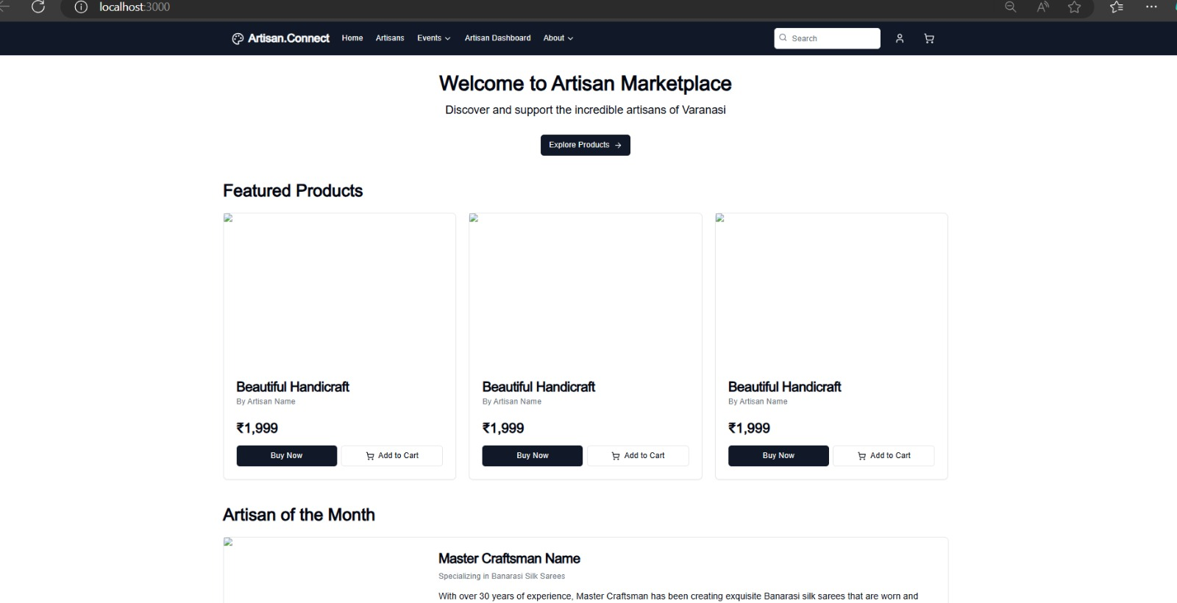
Expected Outcomes

Slide 12
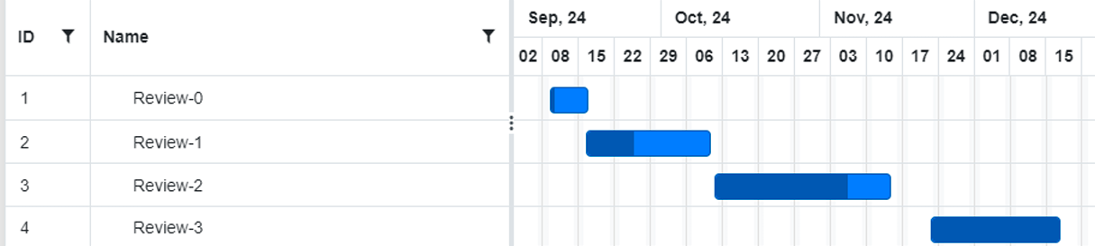
Timeline of the Project (Gantt Chart)

Slide 13
CONCLUSION
The Artisan Empowerment Platform aims to revitalize the textile and handicraft sector by harnessing the power of technology. By providing artisans with a dedicated space to showcase their skills, this project seeks to foster community engagement, ensure authenticity, and facilitate access to global markets. The initial front-end development phase has laid a strong foundation for future expansion into back-end functionalities.

Slide 14
References (IEEE Paper format)
E. Freeman, S. Robson, and R. Freeman, Full Stack JavaScript Development with MEAN. New York, NY, USA: Apress, 2018.
R. Nixon, Learning PHP, MySQL & JavaScript: A Step-by-Step Guide to Creating Dynamic Websites. Sebastopol, CA, USA: O'Reilly Media, 2020.
MDN Web Docs, "HTML, CSS, and JavaScript Documentation," Mozilla Foundation, [Online]. Available: https://developer.mozilla.org/. [Accessed: Sep. 17, 2024].
W3Schools, "Web Development Tutorials," [Online]. Available: https://www.w3schools.com/. [Accessed: Sep. 17, 2024].
C. Benson and S. Loftness, Payment Systems in the U.S.. Boston, MA, USA: National Institute of Standards and Technology, 2018.
OWASP Foundation, "Open Web Application Security Project," [Online]. Available: https://owasp.org/. [Accessed: Sep. 17, 2024].
J. Allen, Event Planning: The Ultimate Guide to Successful Meetings, Corporate Events, Fundraising Galas, Conferences, Conventions, Incentives, and Other Special Events. Hoboken, NJ, USA: Wiley, 2012.

Slide 15


